Slide 1
Chapter 2 - Pointers
Learning outcomes:
Describe the idea of a pointer
Apply declaration & initialization of pointers
Perform assignments & arithmetic of pointers
Relate pointer & array, discuss array of pointers
Describe dynamic memory allocation
Create & apply dynamic variables, and arrays
Explain memory leak and dangling pointers

Slide 2
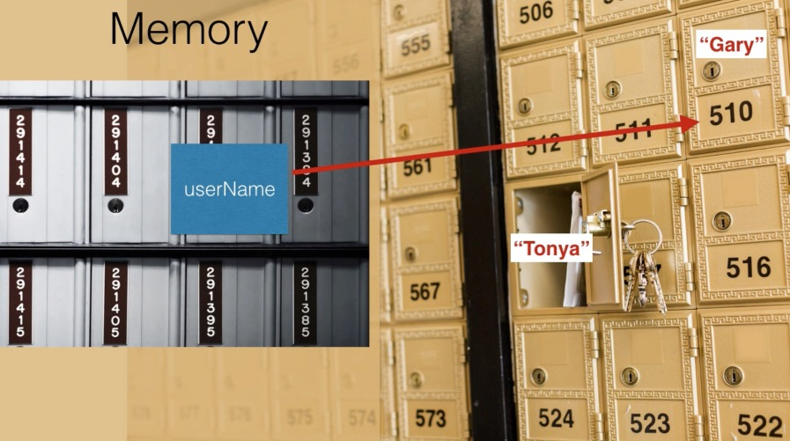
Introduction
Variable
can be seen as a memory cell, accessed using an identifier.
has a unique address in the memory, & addresses follows successive pattern.
an address of a variable in the memory is known as reference
e.g., 0x61fe1c // 8-bit, hexadecimal value
Pointer
a variable that stores the address of another variable

Slide 3
Cont’d…
Some uses of pointers:
allow access to memory locations, which regular variables do not
allow to work with strings & arrays, more efficiently
allow to create arbitrarily-sized array of values in the memory
allow to create “dynamic variables”, or to dynamically allocate memory

Slide 4
Cont’d…
Reference operator (&)
& also known as “address of operator”
return the address of a variable in the memory
Examples,
int num = 23;
cout<<&num; // output the address of num
int andy = 25;
int fred = andy;
// assign the address of andy to ted
ted = &andy;

Slide 5
Cont’d…
Dereference operator (*)
* also known as “indirection operator”
return the value pointed to by a pointer
Example
int andy = 25;
ted = &andy;
// assign the value pointed by ted to beth
int beth;
beth = *ted;
* and & are inverse of each other,
e.g., cout<<(*)&ted;
cout<<(&)*ted; // both outputs the address of andy
andy

Slide 6
Declaring Pointer
Syntax: type *pointerName; // * indicate a pointer
e.g., int *myPtr; // declare a pointer myPtr to int type
Can declare a pointer to any data type,
e.g., char *x; // declare a pointer to a char
Pointer type: must be of the same type,
e.g., int x = 25;
int *p; // p can point to x
Declaring multiple pointers, of the same type,
e.g., int *myPtr1, *myPtr2;

Slide 7
Initializing Pointer
Syntax: type *pointerName = intialValue;
intialValue: address of a variable or a NULL value (or 0)
Example,
int x;
int *y = &x; // initialize pointer y with the address of x
Initial value must have the same type,
e.g., float x;
int *ptr = &x; // error: can not assign float to int
If not the same type,
need explicit “type casting”

Slide 8
Cont’d…
If not initialized to an address of a variable,
good to initialize to a NULL value (or 0)
Example,
int *ip = NULL; // ip is a “Null pointer”
char *cp = NULL; // ip & cp points to null value
cout<<ip; // output 0
NULL can be initialized, to pointers of any type, but
cannot be dereferenced, e.g., cout<<*ip; // cause run time error
Pointers can be also initialized with an array name,
e.g., int num[10];
int *ptr = num; // num holds address of the first element

Slide 9
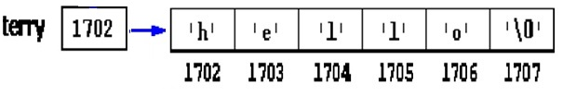
Cont’d…
Example,
Cout<<&num[0];
Cout<<ptr; // both outputs the same result
Pointers can be also initialized to a string constant,
e.g., char *terry = "hello";
create arbitrary-sized array, & store "hello" as a string, and
create pointer terry, & points to the address of the 1st element

Slide 10
Cont’d…
A pointer to another pointer
e.g., char a = 'z';
char *b;
b = &a;
Void pointer
syntax: void *ptrName;
also know as “generic” pointer
can point to variables of any type
cannot be dereferenced // cause compilation error
char **c;
c = &b;

Slide 11
Cont’d…
Example
int x = 5;
void *ptr=&x;
cout<<ptr; // output the address of x
cout<<*ptr; // error: cannot be dereferenced
To dereference,
need an explicit “type casting”, to another typed pointer
e.g., int *num; // because x has int type
num = (int*)ptr; // type cast ptr to int
cout<<*num;
cout<<*((int*)ptr); // or use it directly

Slide 12
Constant Pointer
Constant pointer
always point to the same address (or memory location)
default for array name // always point to address of 1st element
To declare,
syntax: type *const ptrName = intialValue;
Example,
int x, y;
int *const ptr = &x; // must be initialized when declared
*ptr = 7;
ptr = &y; // error: cannot change location

Slide 13
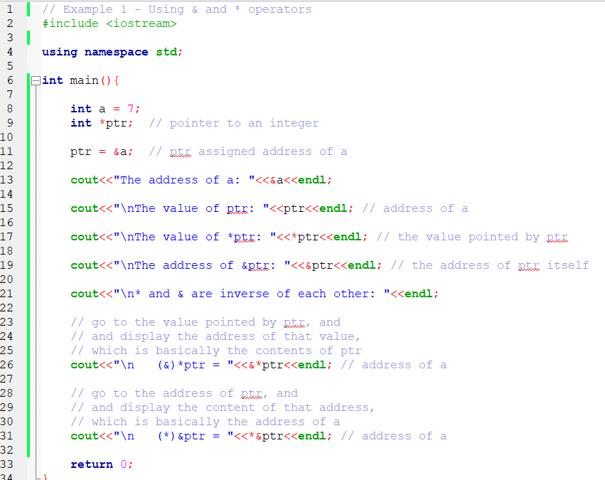
Example 1

Slide 14
Pointer Assignment
Pointer to pointer, if the same type,
e.g., int x = 2;
int *p1 = &x;
int *p2;
p2 = p1; // assign the address hold by p1 to p2
Do not confuse with,
e.g., *p1 = *p2; // assign the value pointed by p1 to p2
If has no same type, must be type casted
e.g., float *p3;
p3 = p1; // implicitly upcast p1 to float

Slide 15
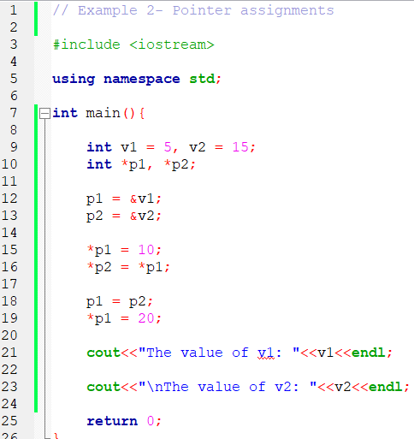
Example 2

Slide 16
Pointer Arithmetic
Valid operations,
increment/decrement pointer(++ or --)
add/subtract an integer to/from a pointer( + or -)
subtract one pointer from another pointer
Pointer arithmetic is meaningful,
when performed on a pointer to array
sizeof(), unary operator
return the size of operand (in bytes)
used along with variables, data types, constant values

Slide 17
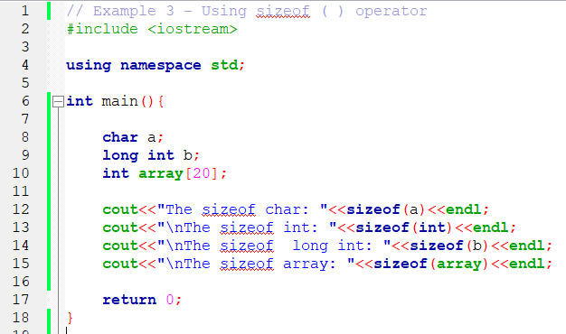
Example 3

Slide 18
+/- Integer to Pointer
Example,
int v[5]; // assume size of int is 2 bytes
int *vPtr = v; // vPtr points to v[0]
vPtr += 2; // 3000 + 2(*2) = 3004
sets vPtr to 3004
vPtr points to v[2]
3000
3002
3004
3006
3008
v[0]
v[1]
v[2]
v[3]
v[4]
vPtr

Slide 19
Pointers Subtraction
Example,
int *vPtr2;
vPtr = &v[0]; // vPtr = 3000
vPtr2 = &v[2]; // vPtr2 = 3004
int n;
n = vPtr2 - vPtr; // n equals 2 (elements)

Slide 20
Pointer ++/--
Example,
vPtr = v[0]; // vPtr = 3000
vPtr++; // 3000 + 1*2 = 3002
sets vPtr to 3002
vPtr points to v[1]
vPtr--; // 3002 - 1*2 = 3000
Also consider,
vPtr = v[0];
cout<<*vPtr++; // same as cout<<(*vPtr)++ ;

Slide 21
Pointers Comparison
Equality or relational operators (</<=, >/>=)
e.g., if (ptr1 == ptr2)
compare the addresses stored in ptr1 and ptr2
Pointer comparison is meaningful,
when performed on pointers to the same array
Also commonly used,
to check whether a pointer is pointing to NULL or not
e.g., if (ptr != NULL)

Slide 22
Pointer & Array
Array (name) is like a (constant) pointer,
always points to the address of 1st element
Example,
int vals[]={4, 7, 11};
cout<<&vals[0]; // output address of 1st element
cout<<vals; // same as &vals[0]
Array acting-like a pointer variable,
e.g., cout<<*vals; // same as cout<<vals[0]
cout<<*(vals + 2); // same as cout<<vals[2]

Slide 23
Cont’d…
A pointer to an array variable,
e.g., int vals[]={4, 7, 11};
int *ptr = vals;
cout<<*(ptr + 1); // output 7
Pointer acting-like an array variable,
e.g., cout<<ptr[3]; // same as cout<<vals[3]
To get address of individual array elements,
e.g., cout<<&vals[3]; // output the address the 3rd element

Slide 24
Cont’d…
2D array acting-like a pointer variable,
e.g., int nums[2][3] = {{16,18,20}, {25,26,27}};
cout<<*(*(nums + i) + j); // same as cout<<nums[i][j]
Pointer Notation | Array Notation | Value
*(*nums + 0) | nums [0][0] | 16
*(*nums + 1) | nums [0][1] | 18
*(*nums + 2) | nums [0][2] | 20
*(*(nums + 1) + 0) | nums [1][0] | 25
*(*(nums + 1) + 1) | nums [1][1] | 26
*(*(nums + 1) + 2) | nums [1][2] | 27
i=0
i=1

Slide 25
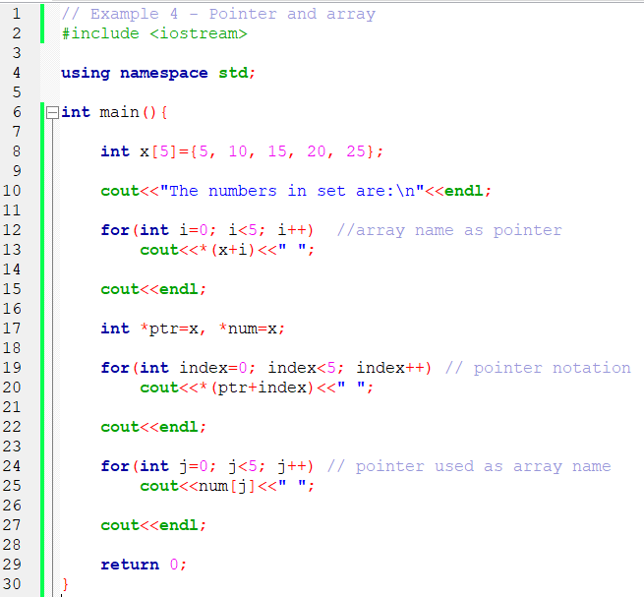
Example 4

Slide 26
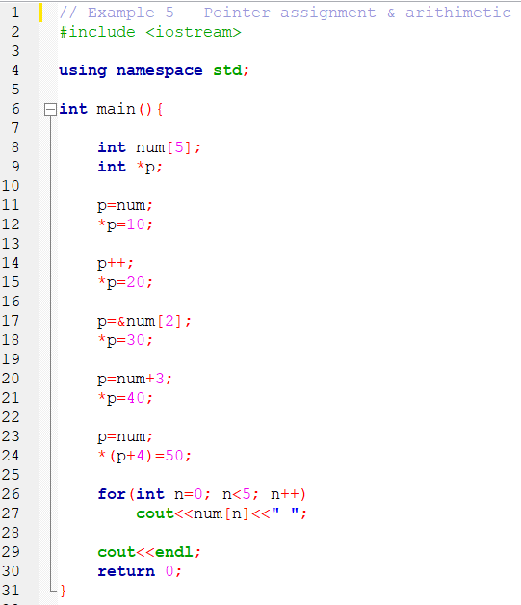
Example 5

Slide 27
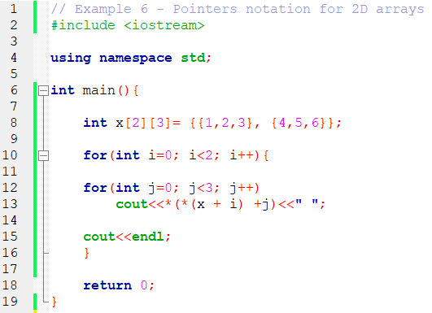
Example 6

Slide 28
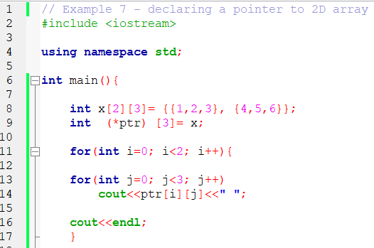
Example 7

Slide 29
Array of Pointers
To declare,
syntax: type *ptrName[size];
Example,
char *seasons[4];
each element point to an address of a char array
To initialize,
e.g., char *suit[4] = {"Hearts", "Diamonds“, "Clubs", "Spades"};
suit[0]
’H’
’e’
’a’
’r’
’t’
’s’
’\0’
suit[1]
’D’
’i’
’a’
’m’
’o’
’n’
’d’
’s’
’\0’
suit[2]
’C’
’l’
’u’
’b’
’s’
’\0’
suit[3]
’S’
’p’
’a’
’d’
’e’
’s’
’\0’

Slide 30
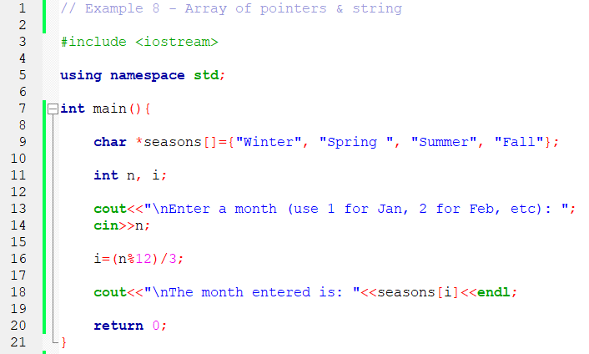
Example 8

Slide 31
Dynamic Memory Allocation
Variables declared,
enough amount of memory space reserved, to hold the data type
and the space is allocated, during the program compilation time,
or before the program execution begins
this kind of allocation known as “static” memory allocation,
where space is reserved for variables on “stack memory”
What if we want the user to determine the amount of memory required for a variable, as the program is running?
this kind of allocation known as “dynamic” memory allocation,
where space is reserved for variables on “heap memory”,
using a pointer variable

Slide 32
Cont’d…
Dynamic memory allocation, can be useful,
to create an array, where the size was unknown, until run time
to create complex data structures, where the size were unknown, and/or need to be constructed as the program was running
to create objects of complex structures, where the constructor arguments were unknown, until run time

Slide 33
Dynamic Variable
To create dynamic variable,
need to use a pointer variable
created with a new operator
Dynamic variables
created & destroyed while the program is running
new operator: used to allocate memory dynamically // on heap
delete operator: used to deallocate memory // free allocated space

Slide 34
New Operator
new operator
If memory available, allocate memory dynamically
& return the address of the new memory location to a pointer
To create, a dynamic variable
syntax: type *pointerName = new type;
Example
int *bobby = new int;
create a new "nameless" variable,
and assign bobby to "point to" it

Slide 35
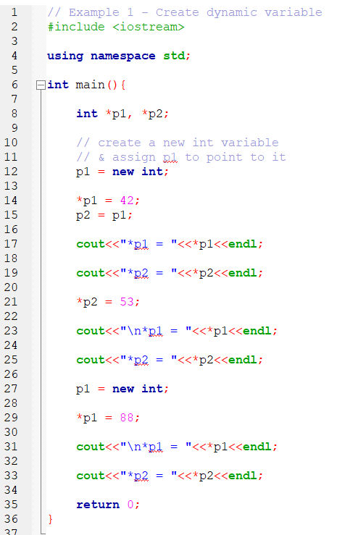
Example 1

Slide 36
Cont’d…
Stack memory
allocated for automatic variables & function variables
Heap memory
allocated for dynamic variables // created using new operator
If sufficient memory not available,
new operator return an exception error, // known as “bad_alloc”
and the program crash or terminate.
Warning:
always check the requested memory was allocated successfully?

Slide 37
Cont’d…
C++ standard approaches,
handling exceptions
using try-throw-catch statement,
or using nothrow object (with new operator)
new operator return NULL value,
// execution of the program continues
Exception handling
the most used approach
not to be discussed here (CH 7)

Slide 38
Cont’d…
Using the nothrow object
e.g., int *bobby;
bobby = new (nothrow) int [5];
to check the memory was allocated successfully?
if (bobby == NULL)
{
statement; // print error
…… // apply fixes
}

Slide 39
Dynamic Array
Standard array
e.g., int x[10];
maximum size must be specified first,
actual size may not be known sometimes, until program runs
thus, may lead to memory wastage
Dynamic array
size is not specified, at programming time
can be determined while the program is running
syntax: type ptrName = new type [size];

Slide 40
Cont’d…
Example,
int *bobby = new int[i];
assigns space for i elements of type int
and return a pointer to the 1st element
the value of i is determined by user, as the program is running
cout<<*bobby; // same as bobby[0]

Slide 41
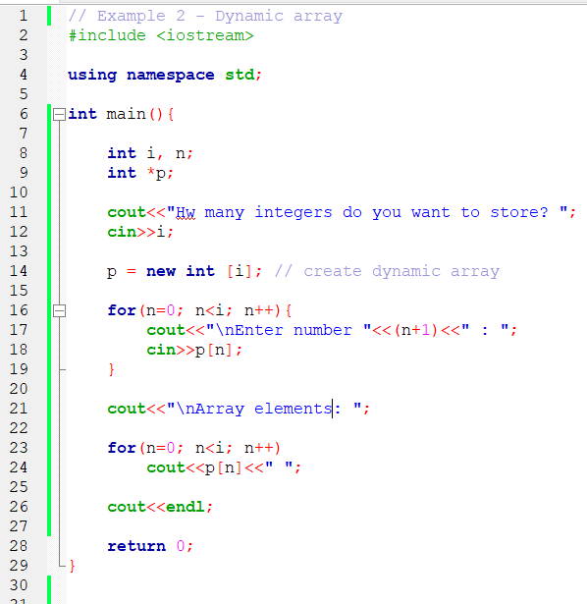
Example 2

Slide 42
Delete Operator
delete Operator
deallocate dynamic variables // created by new operator
allocated memory is released to heap memory,
the pointer is then become unassigned pointer
To delete a dynamic variable,
syntax: delete pointerName;
e.g., int *p = new int;
delete p;
delete [] pointerName; // for 2D dynamic array

Slide 43
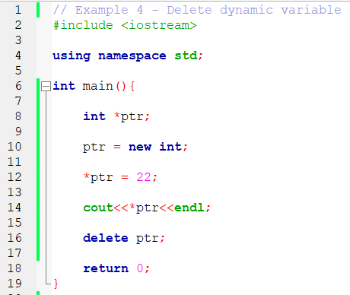
Example 4

Slide 44
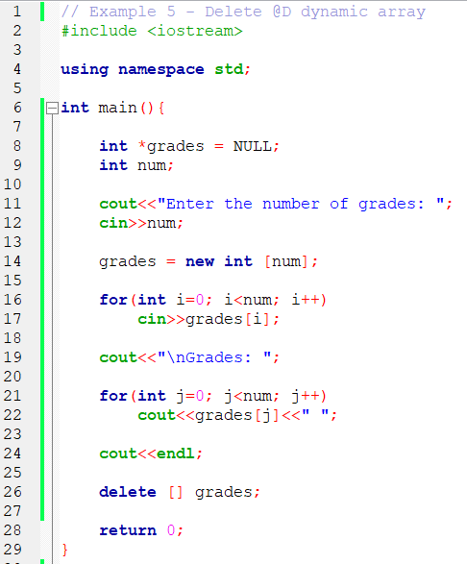
Example 5

Slide 45
Memory Leak & Dangling Pointer
Memory leak
pointer reassigned, without deleting the previous memory
result in the loss of memory space
solution: free the memory after use, i.e., delete p;
Dangling pointer
contain the address of memory that has been deleted
dereferencing, may produce unpredictable result
solution: assign pointer to NULL, as soon as the memory is deleted
i.e., delete p;
p = NULL;

Slide 46
Example 6
ptr1
int *ptr1 = new int;
int *ptr2 = new int;
*ptr1 = 8;
*ptr2 = 5;
ptr2 = ptr1;
8
ptr2
5
ptr1
8
ptr2
5
Solution: _________?
“memory leaked”

Slide 47
Example 7
ptr1
int *ptr1 = new int;
int *ptr2;
*ptr1 = 8;
ptr2 = ptr1;
delete ptr1;
8
ptr2
ptr1
ptr2
Solution: _________?
“dangling pointer”

